Slide 1
Online Newspaper with android based mobile Application
Presented By Supervised By
Md. Mehedi Hassan (Roll -21) Mst. Jahanara Akhtar
Md. Mazharul Ananm Chowdury(Roll -27) Associate Professor
Md. Rejaul karim(Roll-23) Dhaka International University
Mubarak Ali kariye(Roll -24)

Slide 2
Overview
Introduction
Objective
Developing Process
Web Application Description
Mobile application Description
Limitation
Future Work

Slide 3
Introduction
Online newspaper with mobile apps project has three tier application :
Web application with admin panel
Web service
Mobile apps

Slide 4
Objective
Publish news in website
Update news in website
Search the news through website
show the news through mobile apps

Slide 5
Developing Process
Design : HTML, CSS, BootStrap,,
Coding Part : php, javascript
Database : MySql
IDE : Android Studio
TextEditor : SublimeText

Slide 6
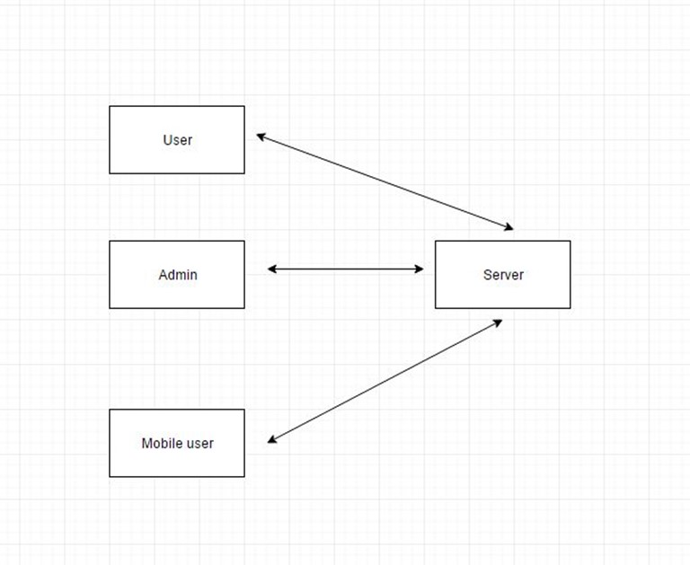
DFD

Slide 7
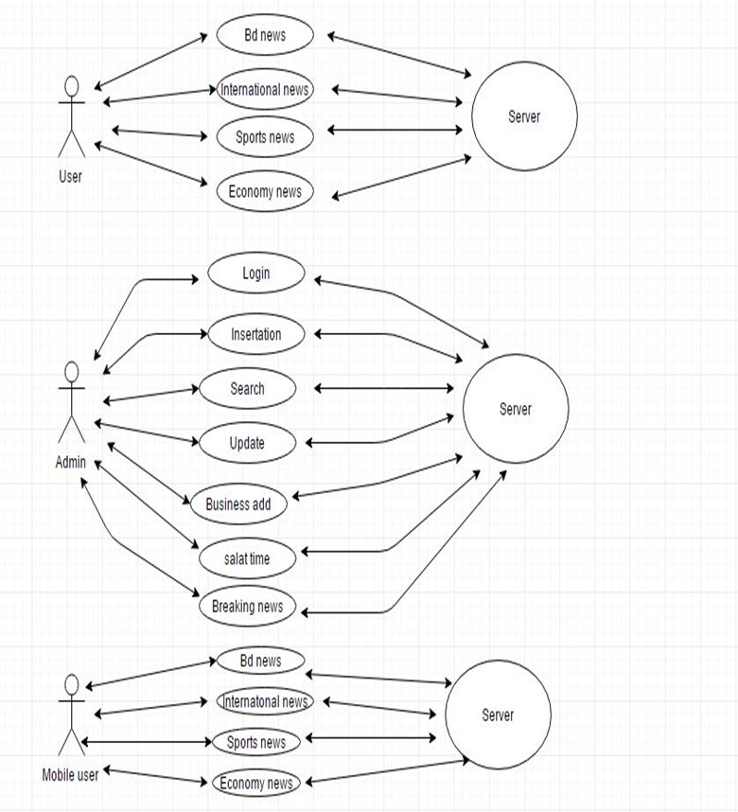
Use Case Study

Slide 8
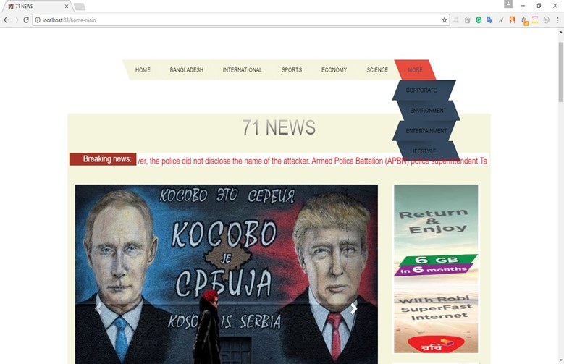
Home Page

Slide 9
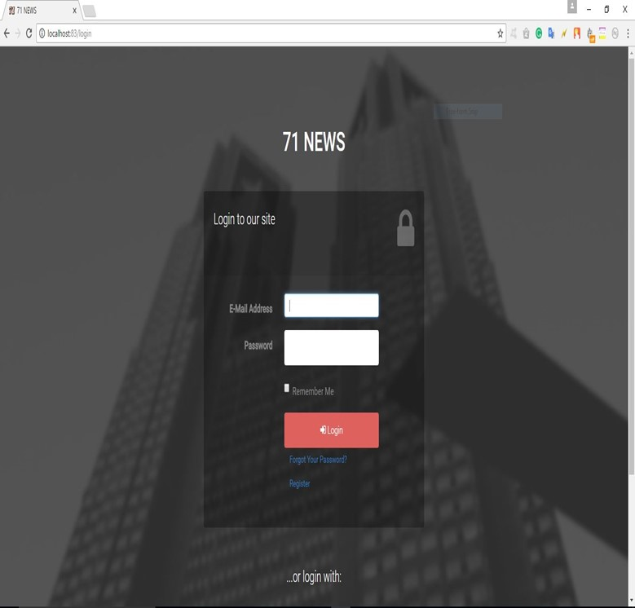
Login Page

Slide 10
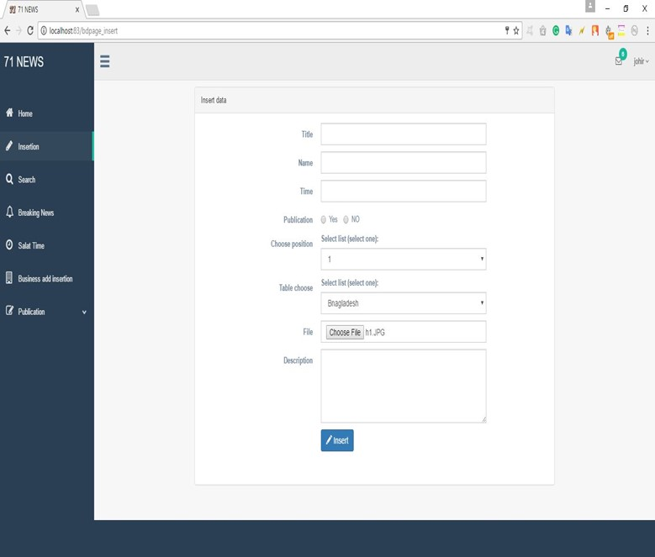
Insert Page

Slide 11
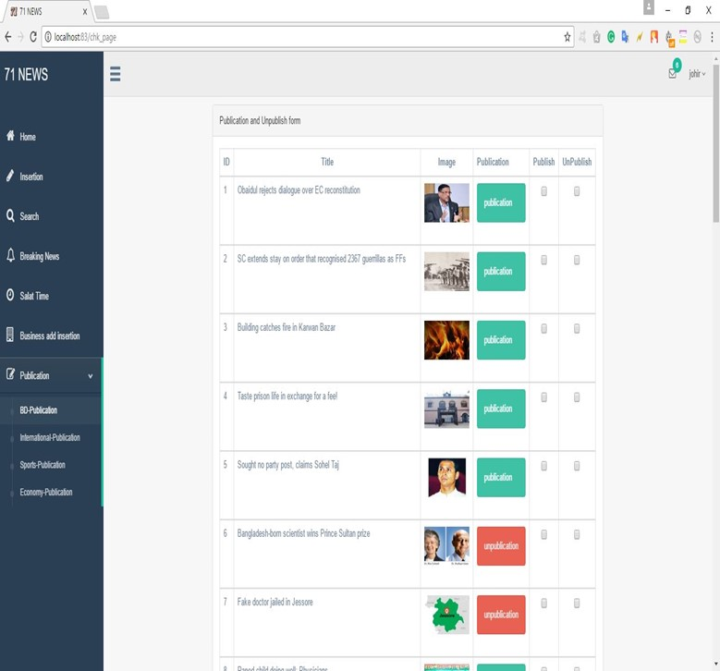
Publication Page

Slide 12
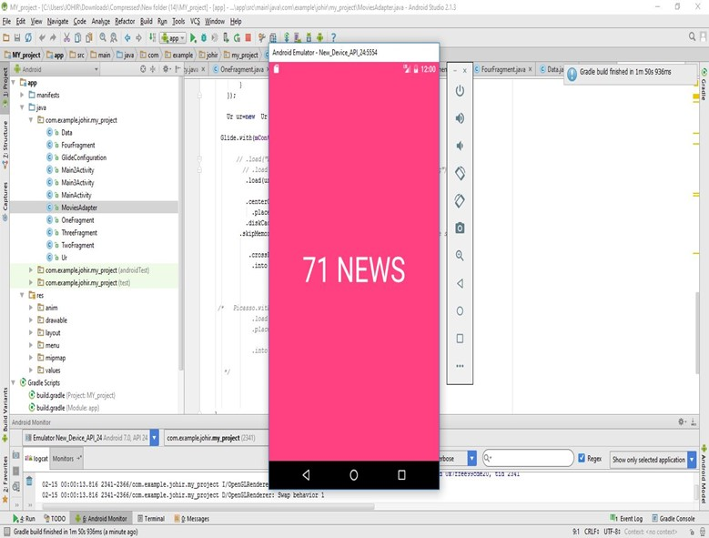
Splash Screen

Slide 13
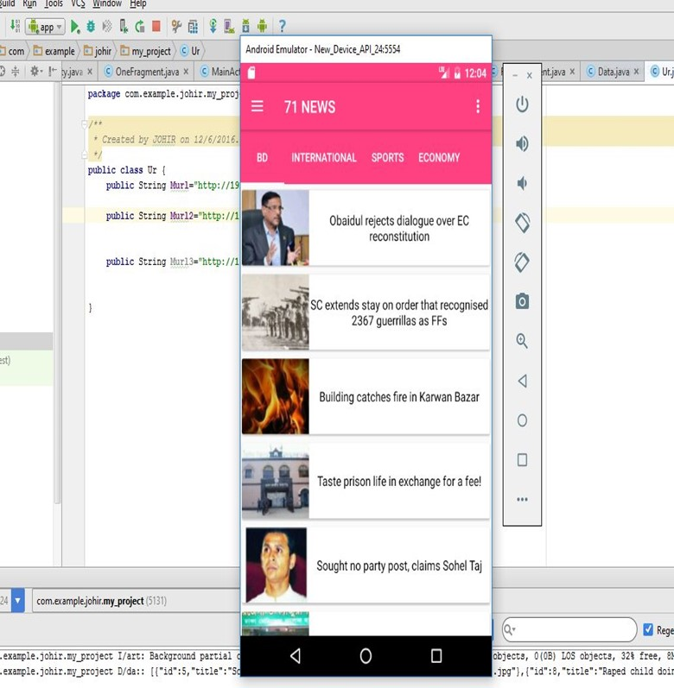
Home Activity

Slide 14
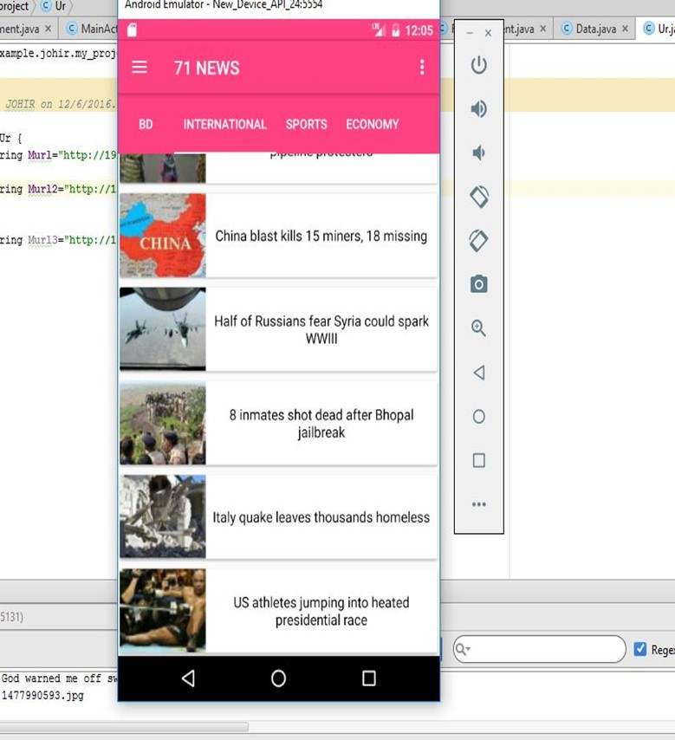
Result

Slide 15
Advantage
Authority can insert their news in their website
search their news in the website
See news in mobile apps

Slide 16
Limitation
Authority can not insert news through the Mobile Apps
Authority can’t filter the news in website as well as apps

Slide 17
Future work
Authority can insert result through the mobile app
Student can get the result subjectwise

Slide 18
Thanks

